Slide 1

Op Wielekes
Depot managing app
Lennert Vandiedonck
Remi Vanhuylebrouck
Constantijn Cardon
Jarne Boone
Daria Chirila

Slide 2
Agenda
About Opwielekes
Previous depot managing app
Our solution
Algorithm
ERD-model
Upscaling
BRAND
CONTENT
PERFORMANCE
2

Slide 3
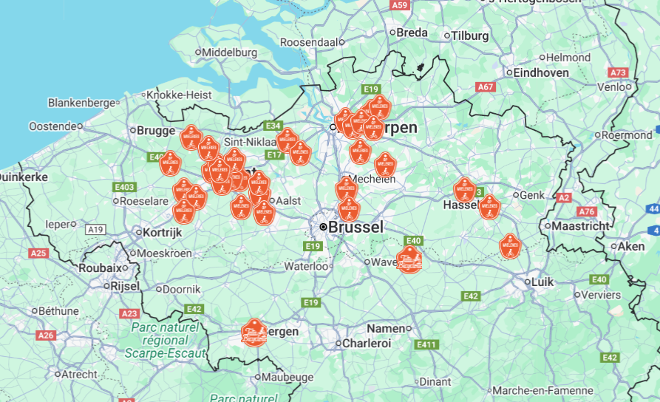
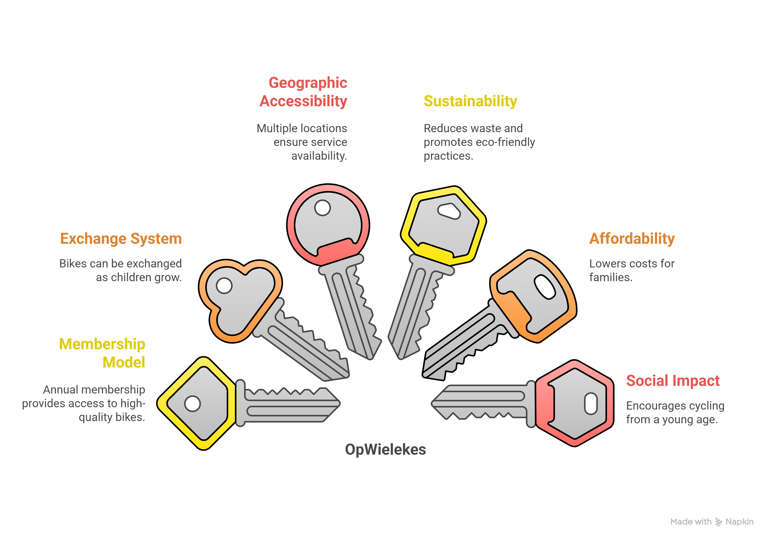
About Op Wielekes
3

Slide 4

Previous app
No data-driven insights or economic added value
Inflexible design with no room for generalization or additional object types
Cluttered and unorganized tables, a lack of operational oversight over the data
4

Slide 5
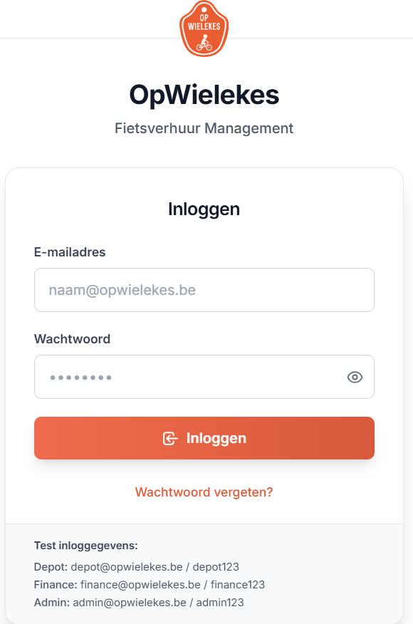
Our solution
Role-based log in
Distinct interfaces for depot, finance, and admin roles
  Depot → access to inventory, members
  Finance → access to rentals, payments
  Admin → access to all
  By separating roles, the app minimizes clutter, allowing staff to focus on their core tasks
5

Slide 6
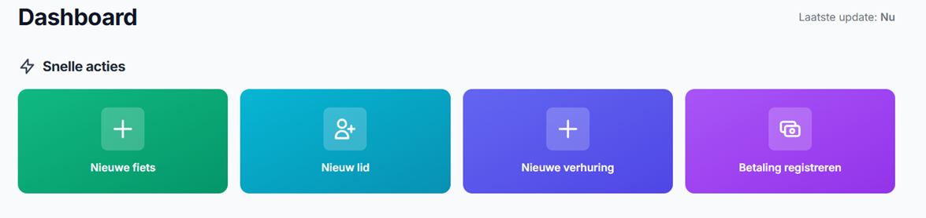
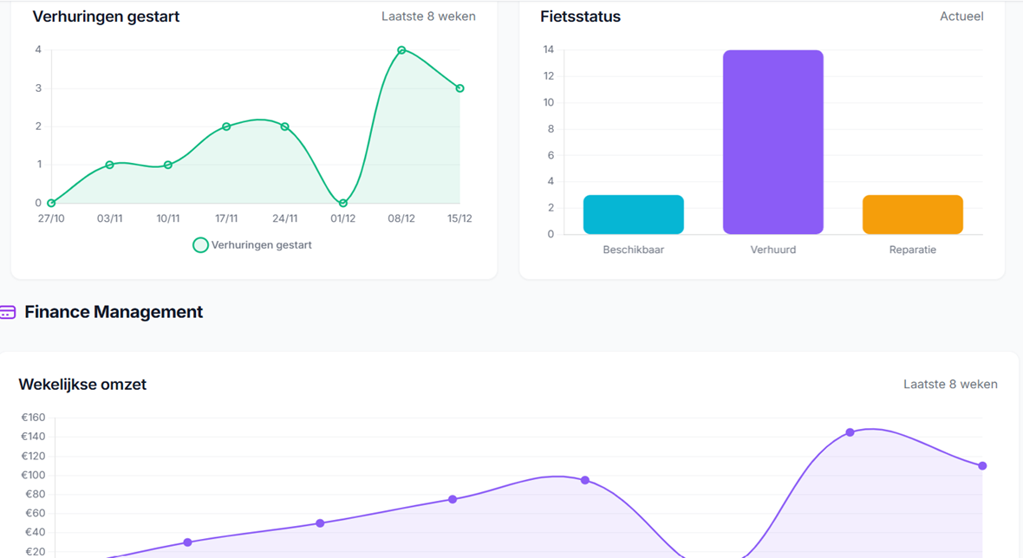
Our solution
Dashboard
Streamline daily operations with "Quick Actions"
  Gain a complete real-time overview of your entire bike inventory
  Monitor performance through visual data tracking
6

Slide 7
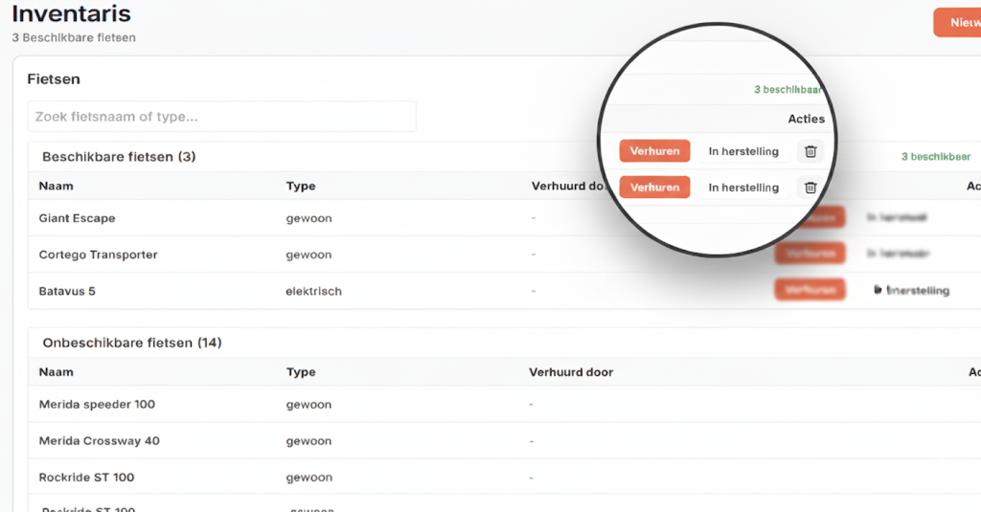
Our solution
Inventory
Maintain a clear overview of all available, rented, and unavailable bicycles and accessories, categorized by type
Streamline operations with direct management tools to initiate rentals, or mark items as in repair or repaired
Allows for the seamless addition of various categories like helmets and accessories to support future growth
7

Slide 8
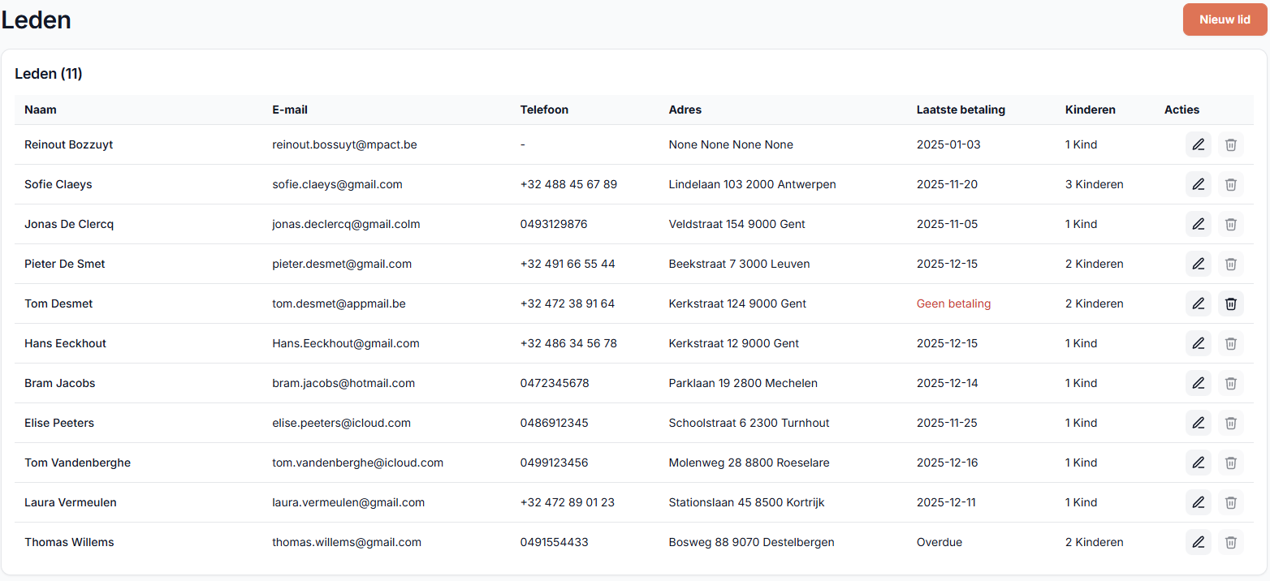
Our solution
Members
Centralized overview of all members with contact and address details
Clear visibility of each member’s latest payment status
Unpaid or missing payments are highlighted in red for quick attention
8

Slide 9
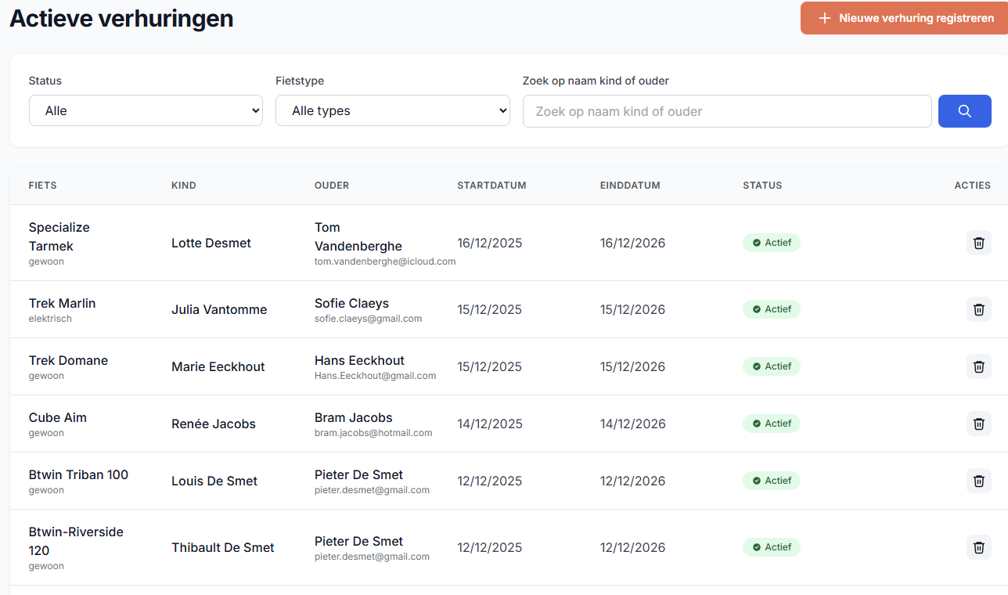
Our solution
Rentals
Provides a clear overview of all active rentals, including bike, child, parent, and rental period
Enables quick filtering and searching by status, bike type, or parent/child name
Simplifies rental management with clear status indicators and direct action buttons
9

Slide 10
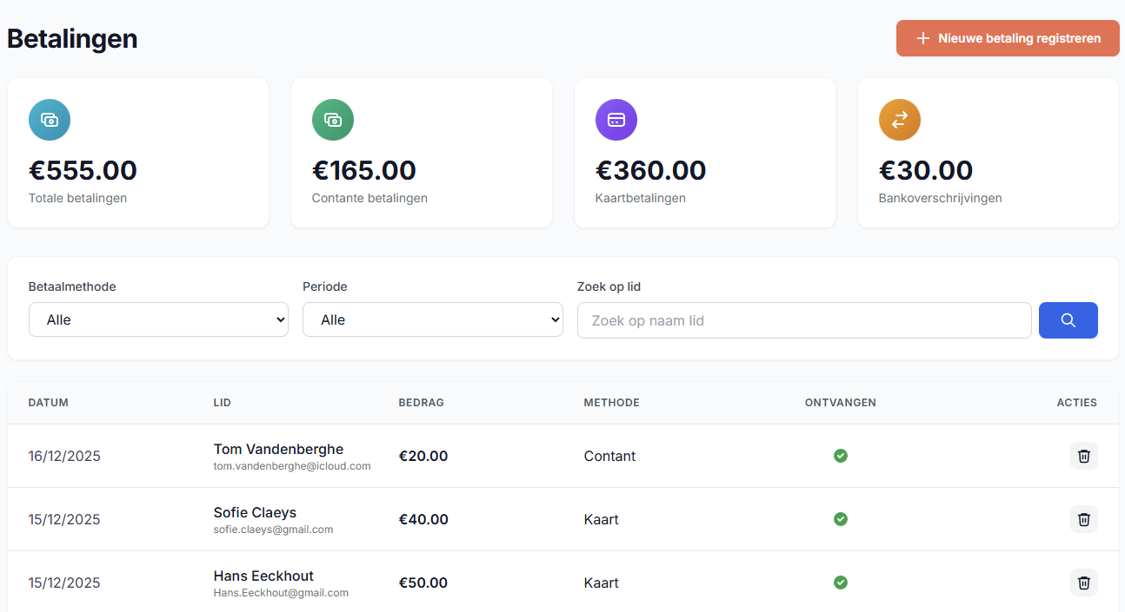
Our solution
Payments
Displays a clear financial overview with totals per payment method and overall revenue
Allows fast filtering by payment method, time period, or member name
Easy visual confirmation of payment status
10

Slide 11

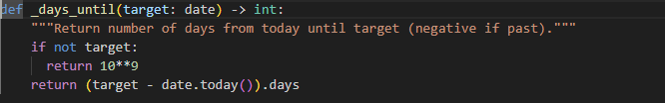
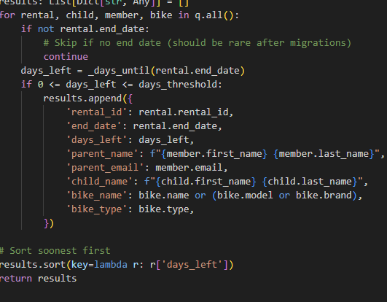
Algorithm
Code
Retrieves all active rentals from the database
Calculates how many days remain until the rental ends
1
2
3
4
5
Filters and sorts rentals expiring within 30 days
11

Slide 12
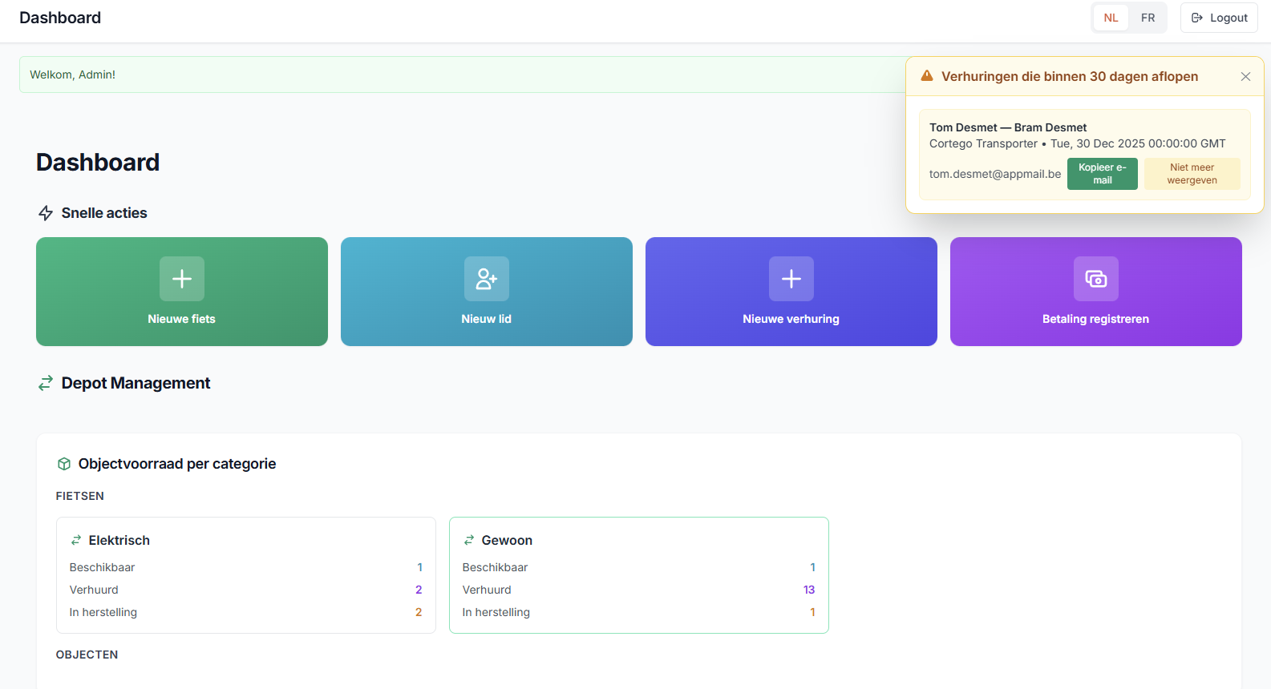
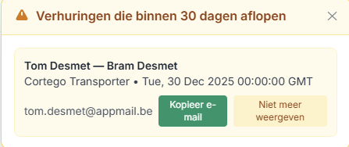
Algorithm
User interface
Clearly highlights rentals expiring within the next 30 days
Provides direct access to parent contact details via one-click email copy
1
2
3
4
5
Helps staff take quick action without leaving the dashboard
12

Slide 13
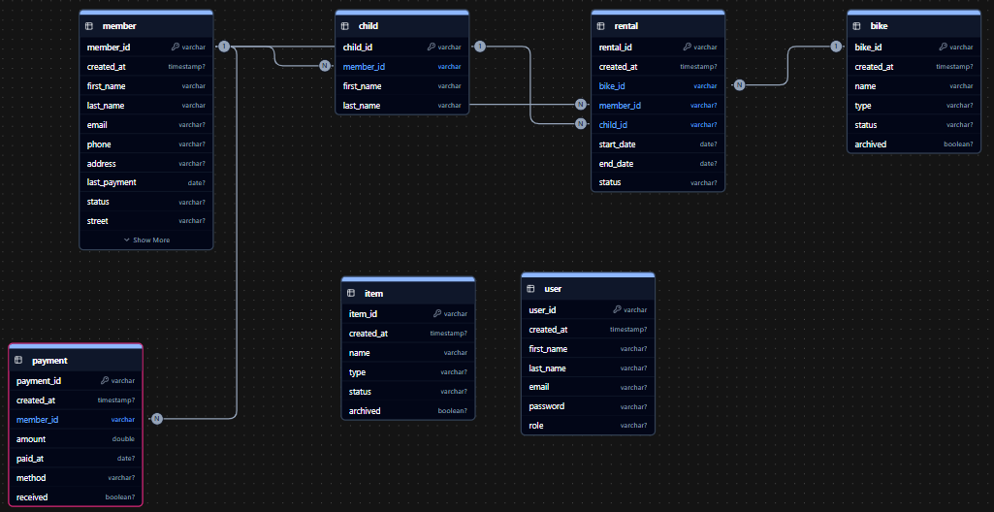
ERD-Model
1
2
3
4
5
13

Slide 14
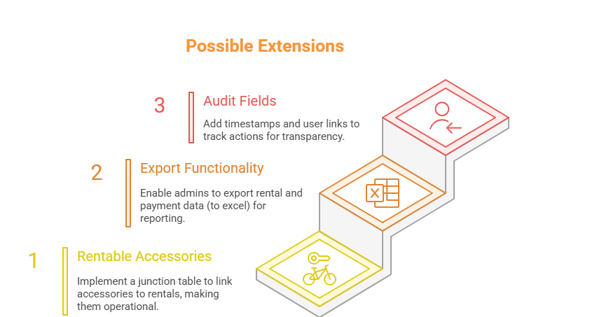
Upscaling
1
2
3
4
5
14

Slide 15
THE END

